Slide 1


What and Why of CORS?

Slide 2
What is Cross-Origin Resource Sharing (CORS).
“Cross-Origin Resource Sharing (CORS) is an HTTP-header based mechanism that allows a server to indicate any origins (domain, scheme, or port) other than its own from which a browser should permit loading resources.”

Slide 3
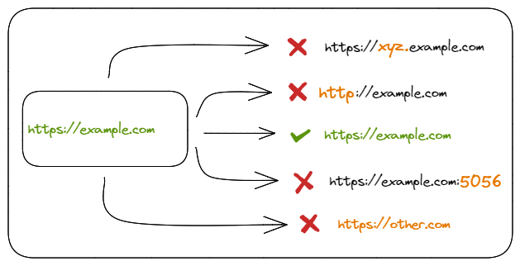
The problem CORS trying to solve.
Sharing the resource safely across the origin is the main issue before the CORS mechanism was introduced.

Slide 4
How does CORS work?
website on "example.com" makes a request to the API on "api.example.org"
Before the actual request is sent, the browser sends a preflight request to the server hosting the API ("api.example.org"). This preflight request is an HTTP OPTIONS request that asks the server whether it will allow the actual request.
The server hosting the API responds to the preflight request with a set of headers that indicate whether the request is allowed or not. These headers include "Access-Control-Allow-Origin", "Access-Control-Allow-Methods", and "Access-Control-Allow-Headers"
If the server responds with headers that allow the request, the browser sends the actual request to the API and retrieves the requested data.

Slide 5
For example, the preflight request might look like this:
OPTIONS /api/data HTTP/1.1
Host: api.example.org
Origin: https://example.com
Access-Control-Request-Method: GET
Access-Control-Request-Headers: authorization
And the server might respond with headers like this:
HTTP/1.1 200 OK
Access-Control-Allow-Origin: https://example.com
Access-Control-Allow-Methods: GET, POST
Access-Control-Allow-Headers: authorization
This indicates that the request from "example.com" is allowed, and the actual GET request to the API can proceed.

Slide 6
Why are you getting a CORS error?
One of the top reasons for CORS errors in development is that the server you are sending a request to might not include the expected access-control-allow-origin header in the responses it sends back to you. Or if it does, it doesn't include your frontend app's URL in the list of approved origins.

Slide 7
Few ways to resolve CORS errors:
Setting CORS headers in the API response.
const express = require('express');
const cors = require('cors');
const app = express();
app.use(cors());
// your API endpoints here
2. Enabling core in server-side API:
app.get('/api', (req, res) => {
res.setHeader('Access-Control-Allow-Origin', '*');
// res.setHeader('Access-Control-Allow-Origin', "https://example.com") allows only the mentioned domain to access the API
res.setHeader('Access-Control-Allow-Methods', 'GET, POST, PUT, DELETE');
res.setHeader('Access-Control-Allow-Headers', 'Content-Type');
// your API logic here
});

Slide 8
THANK YOU

